Slide 1
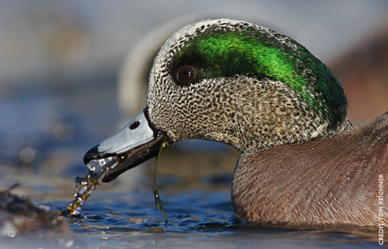

Slide 2
WELCOME TO THE
MID-IOWA DUCKS UNLIMITED
58TH ANNUAL
FALL BANQUET AND AUCTION
THANK YOU FOR ATTENDING!

Slide 3
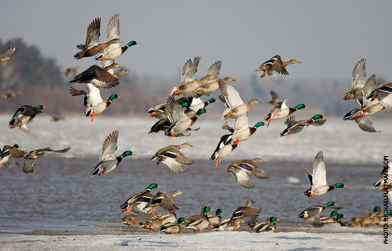

Slide 5
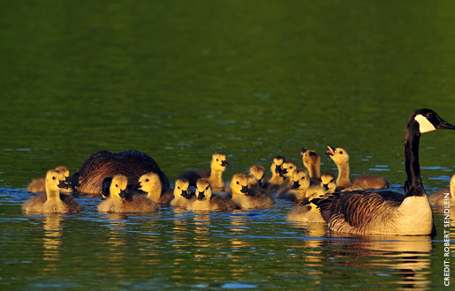

Slide 6
MISSION STATEMENT
Ducks Unlimited conserves, restores, and manages wetlands and associated habitats for North America's waterfowl. These habitats also benefit other wildlife and people.

Slide 7
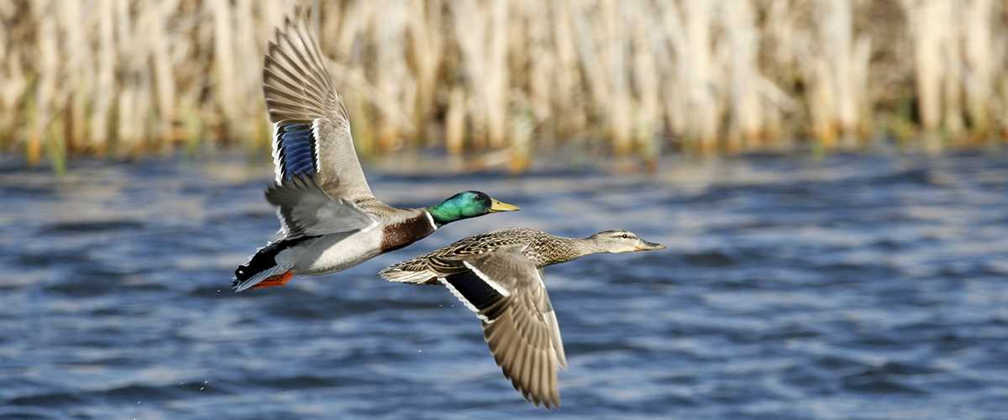

Slide 8
Ducks Unlimited takes a continental, landscape approach to wetland conservation. Since 1937, DU has conserved more than 13 million acres of waterfowl habitat across North America. While DU works in all 50 states, the organization focuses its efforts and resources on the habitats most beneficial to waterfowl.

Slide 9
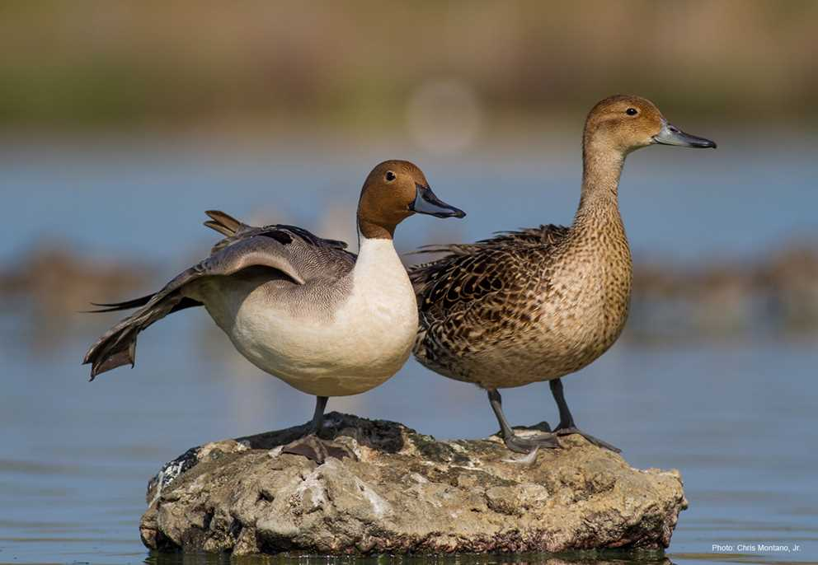

Slide 10
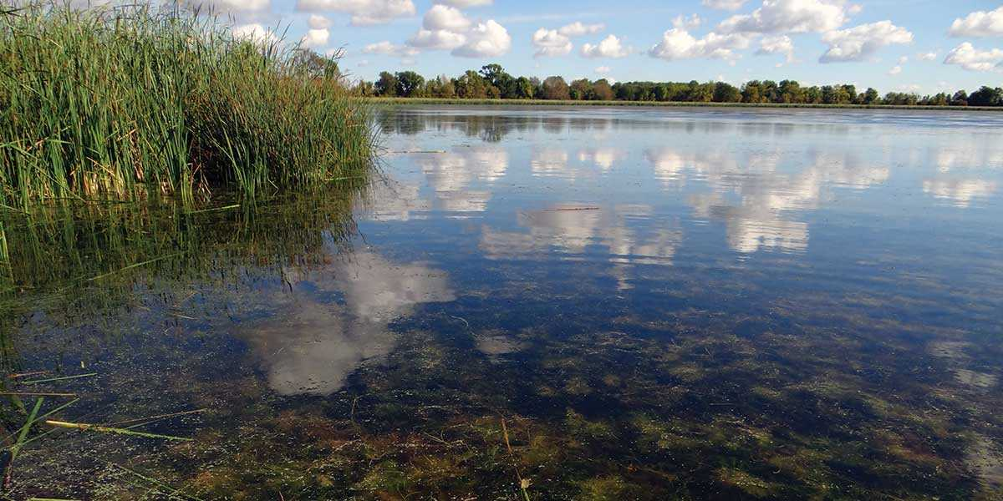
Iowa is part of the Mississippi Flyway and provides important migration habitat for waterfowl that are produced in the Prairie Pothole Region.

Slide 11
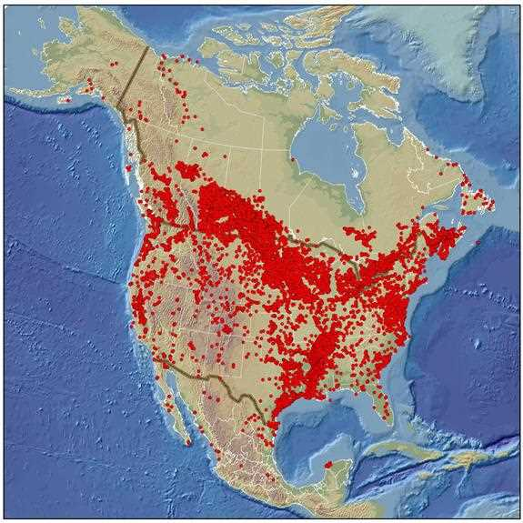
DU works in Iowa through its Living Lakes initiative to restore this important habitat, one lake at a time. Your support of DU will help us achieve that goal.

Slide 12
Mid-Iowa Ducks Unlimited

Slide 13
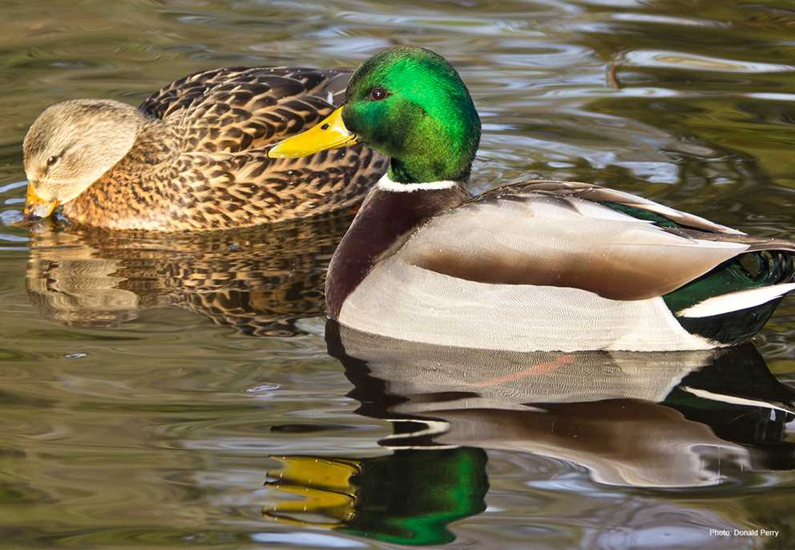

Slide 14
Become a Sponsor,
Save an Acre
All for less than 70¢ per day!
It's a tragic fact: Every 6 minutes, the United States loses nearly one acre of wetlands.

Slide 15
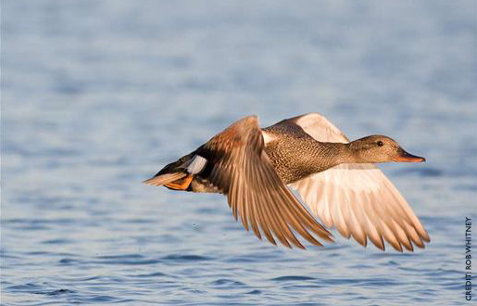

Slide 16
BRONZE SPONSOR
The value of your Bronze sponsorship is greater than $250—you are becoming a steward for the future of wetlands and waterfowl preservation.
And you're saving far more than just one acre—you are laying the foundation for other like-minded conservationists to build on with their donations and their time.

Slide 17
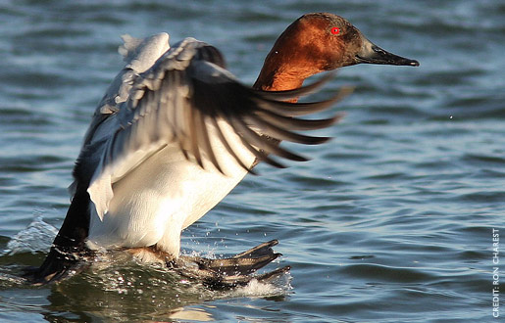

Slide 18
Rescue Our Wetlands
With wetlands losses increasing by 140% in recent years, this campaign, with your help, will conserve and protect threatened waterfowl habitat throughout North America.
Through focused conservation efforts, DU is committed to filling the skies with waterfowl today, tomorrow and forever.

Slide 19
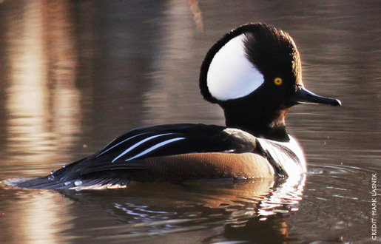

Slide 22
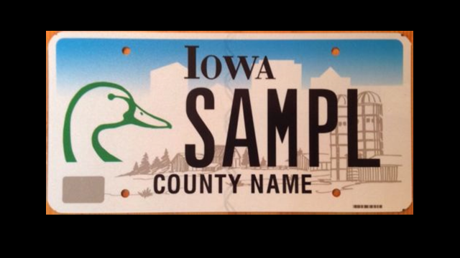

Slide 23
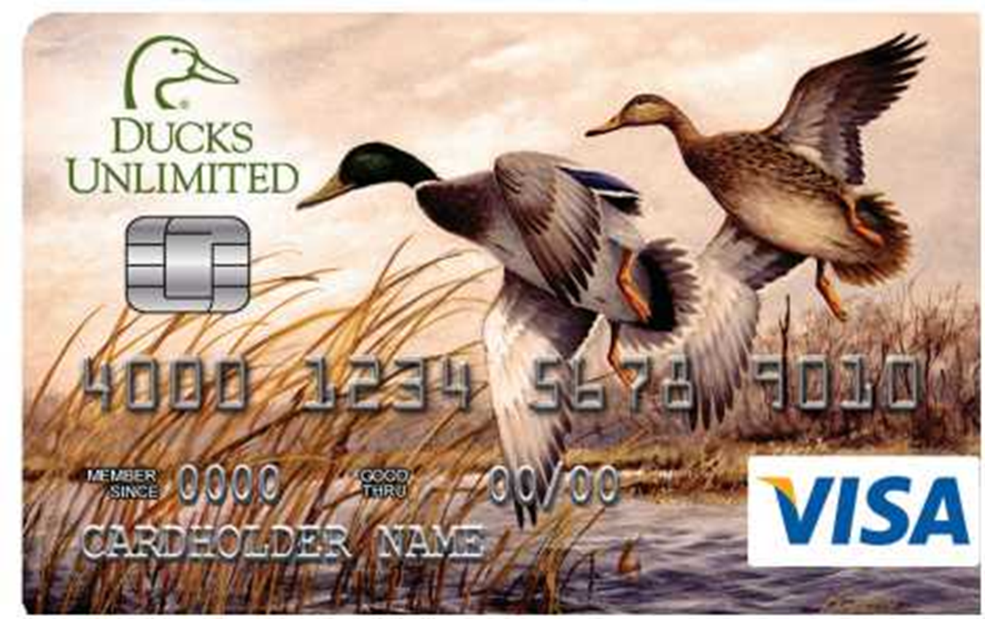

Slide 24
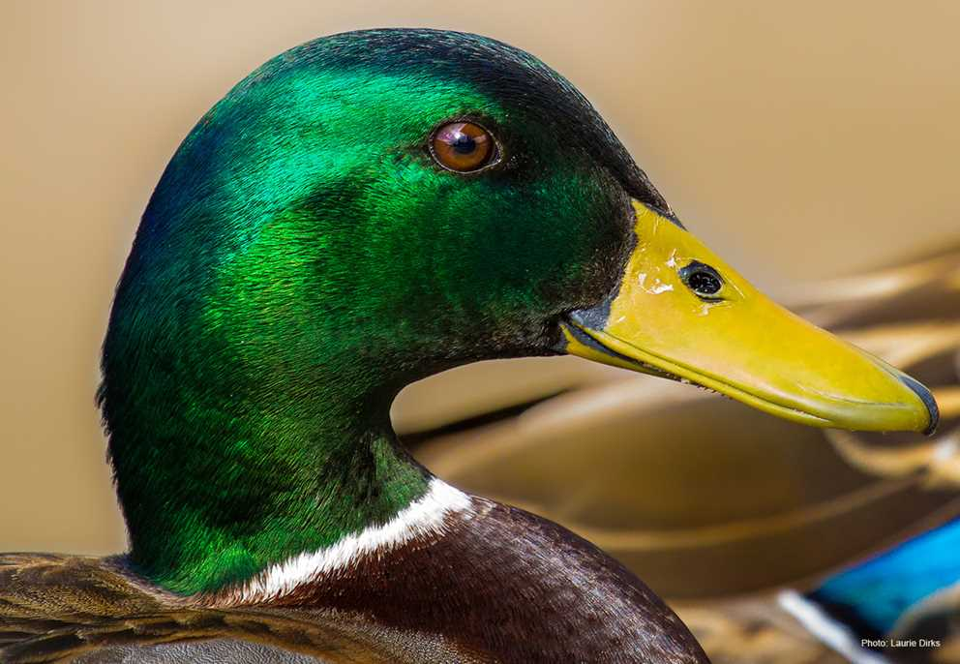

Slide 25
This Evening….
5:00 PM –
6:45 PM
Cocktail Hour
Play Games and Win!
Special Raffles
Browse and Bid on Silent Auction Items
Purchase Raffle Tickets
Browse Live Auction Items

Slide 26
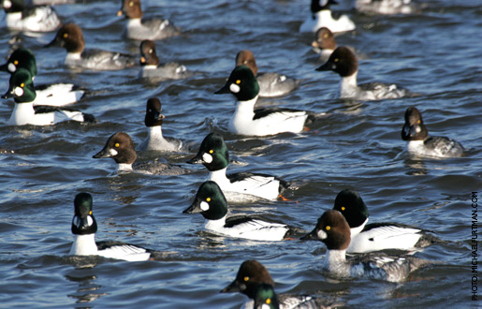

Slide 27
Be sure to check out the Orange & Blue Ticket Raffle Guns
Located on the Southwest
side of the Ballroom

Slide 29
Dinner served at 6:45
Entrees include:
Duck a l’orange
London Broil

Slide 30
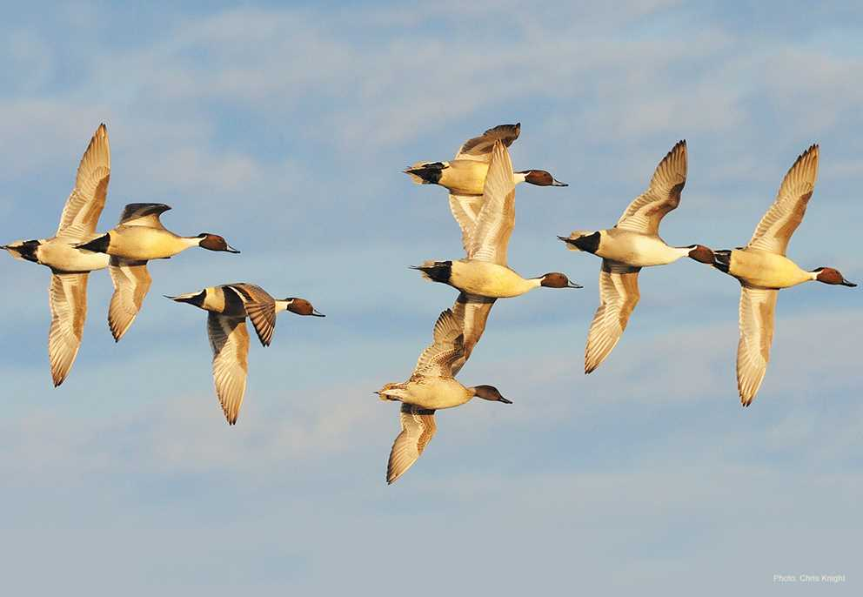

Slide 31
Don’t forget the future of Ducks Unlimited!
It is only $15 for an annual membership
- or -
$200 for a Legacy Membership
Eligible until they turn 21
See TJ in the East lobby for more information

Slide 33
Bronze Sponsorship It’s Easy, It’s Essential, It’s only $250
Benefits:
2- $100 Raffle Packs
Mid-Iowa DU Sponsor Hat or Duck Call
Opportunities to win at least 12 different guns!
Credit given for dinner tickets
and raffle tickets already purchased
See TJ in the East Lobby for information

Slide 34
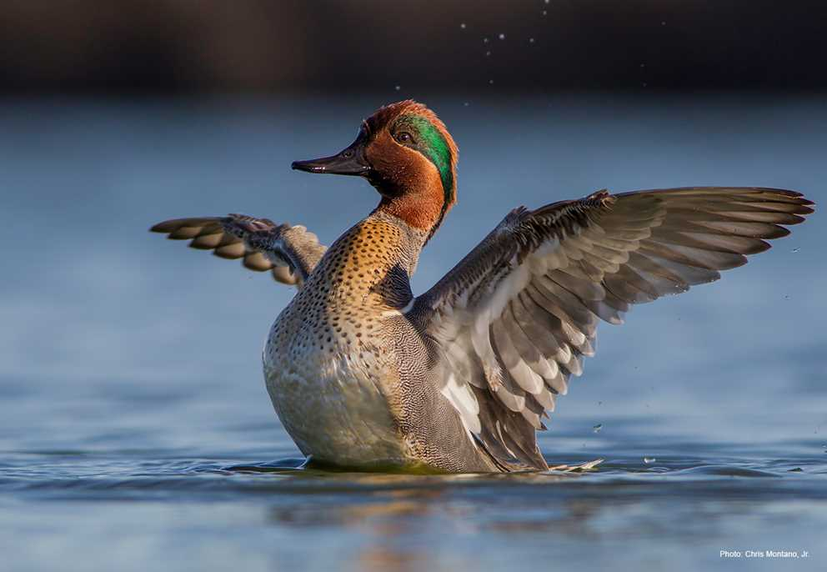

Slide 35
Don’t forget to check out the Silent Auction Items In the East and South sides of the Ballroom
7:40- Round 1 Closes
7:50- Round 2 Closes
8:00- Round 3 Closes

Slide 36
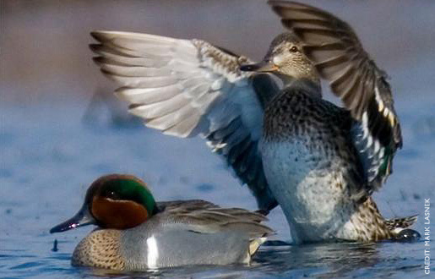

Slide 37
Live Auction 8:00 – 9:00 PM
$100 Raffle Pack Gun Raffle
Sponsor Raffle
General Raffle
9:00 – 10:00 PM

Slide 38
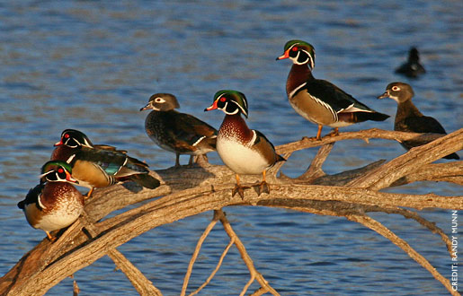

Slide 39
Mid-Iowa Ducks Unlimited 2017 Live Auction
Auctioneer: Chad Daugherty

Slide 40
Item #1 80th Anniversary Canvas Scot Storm “Droppin’ in Canvasbacks”

Slide 41
Item #2 Buck Gardner Mid-IA Duck Call #1
Acrylic Mid-IA
Duck Call
1 in 12 chance for Browning Citori O/U

Slide 42
Item #3 Man Cave Jeep Table

Slide 43
Item #4 2017 Ducks Unlimited Decoy of the Year

Slide 44
Item #5 Docs Hunt Club ½ day Hunt for 2

Slide 45
Item #6 Buck Gardner Mid-IA Duck Call #2
Acrylic Mid-IA
Duck Call
1 in 12 chance for Browning Citori O/U

Slide 46
Item #7 NASCAR Nation- Choice of Tickets to two Races

Slide 47
Item #8 LED Light and Matching Bar Stools

Slide 48
Item #9 Legacy Greenwings

Slide 49
Item #10 2017 Iowa DU Print of the Year “Wood Duck” by Brian Murrillo

Slide 50
Item #11 Pintail Print and Decoy Print by Phillip Crowe

Slide 51
Item #12 NAPA Auto Parts Tool Chest

Slide 52
Item #13 Buck Gardner Mid-IA Duck Call #3
Acrylic Mid-IA
Duck Call
1 in 12 chance for Browning Citori O/U

Slide 53
Item #14 Rob Johnson Fall Hunt One Day Guided Hunt for Four

Slide 54
Item #15 2017 Handgun of the Year Sig Sauer P320 with Holster and 500 Rounds of 9mm

Slide 55
Item #16 Barrel Top Side Table

Slide 56
Item #17 American Flag Painted on Real Wood

Slide 57
Item #18 Buck Gardner Mid-IA Duck Call #4
Acrylic Mid-IA
Duck Call
1 in 12 chance for Browning Citori O/U

Slide 58
Item #19 Retro Mid-Iowa Poster

Slide 59
Item #20 Mid-Iowa Bags Game

Slide 60
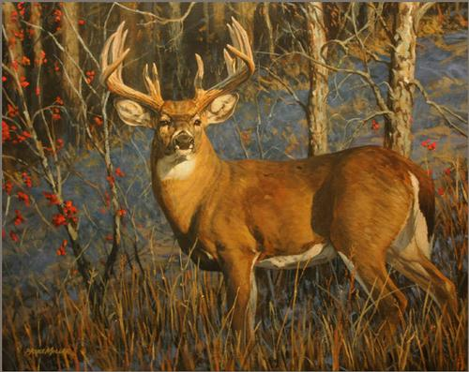
Item #21 Ultimate Deer Package
“Bittersweet Buck” Canvas by Bruce Miller
Milo Locker Deer Processing
Archery Field and Sports Shooting Passes
Ground Blind
Deer Cart

Slide 61
Item #22 Spring Goose Hunt in Riverton One Day, Two Person Hunt with Corn Fed Fowlers

Slide 62
Item #23 Ducks Unlimited/Budweiser Neon Sign

Slide 63
Item #24 Buck Gardner Mid-IA Duck Call #5
Acrylic Mid-IA
Duck Call
1 in 12 chance for Browning Citori O/U

Slide 64
Raffle Time!
$100 Raffle Pack Guns
Sponsor Raffle
General Raffle

Slide 65
Thank you for attending!
Don’t forget!
Visit Salon A to pick up GUNS and pay for Auction Items
Have a safe trip home!
See you next near!

